Slide 1
Animal Machines
Art 4

Slide 2
Objectives:
Students will create original animal machine combinations.
Images will be rendered with Ebony pencil and colored pencil on an ink wash ground

Slide 3
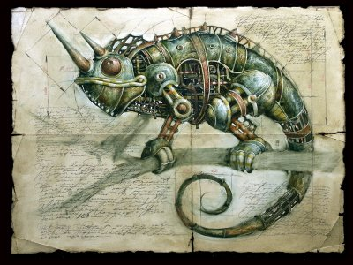

Slide 4
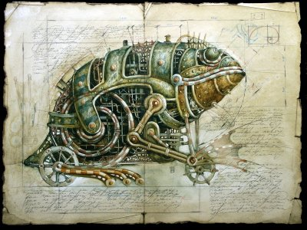

Slide 5
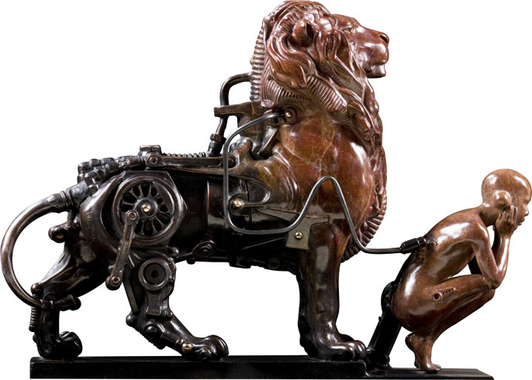

Slide 6
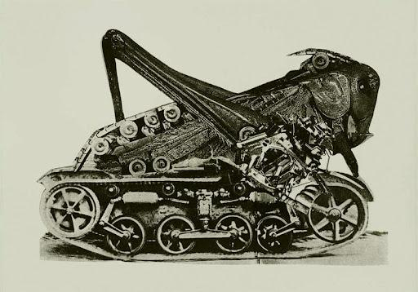

Slide 7
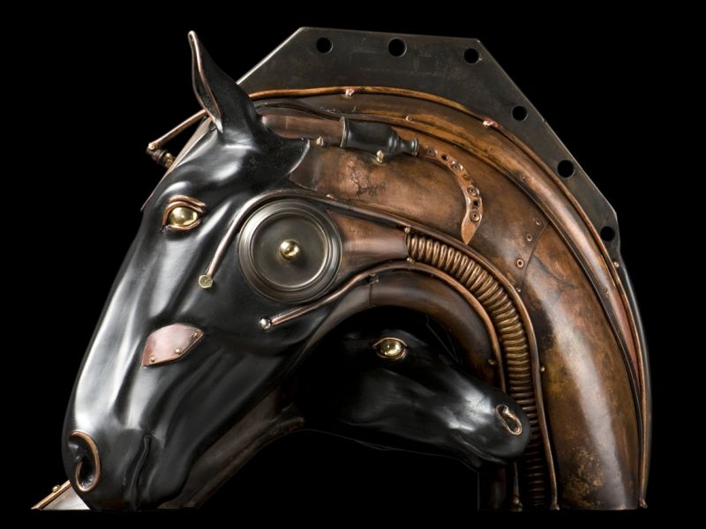

Slide 8
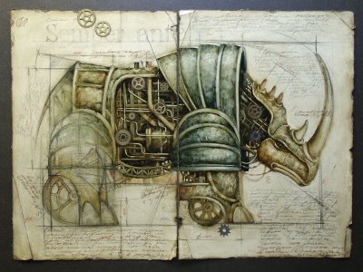

Slide 9
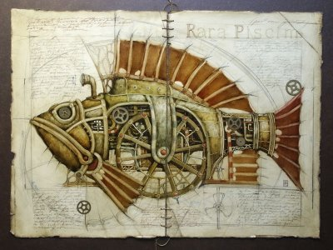

Slide 10
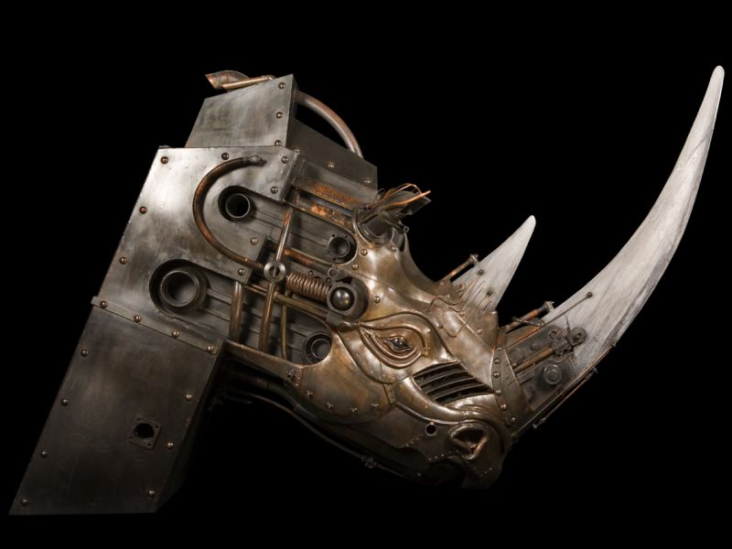

Slide 11
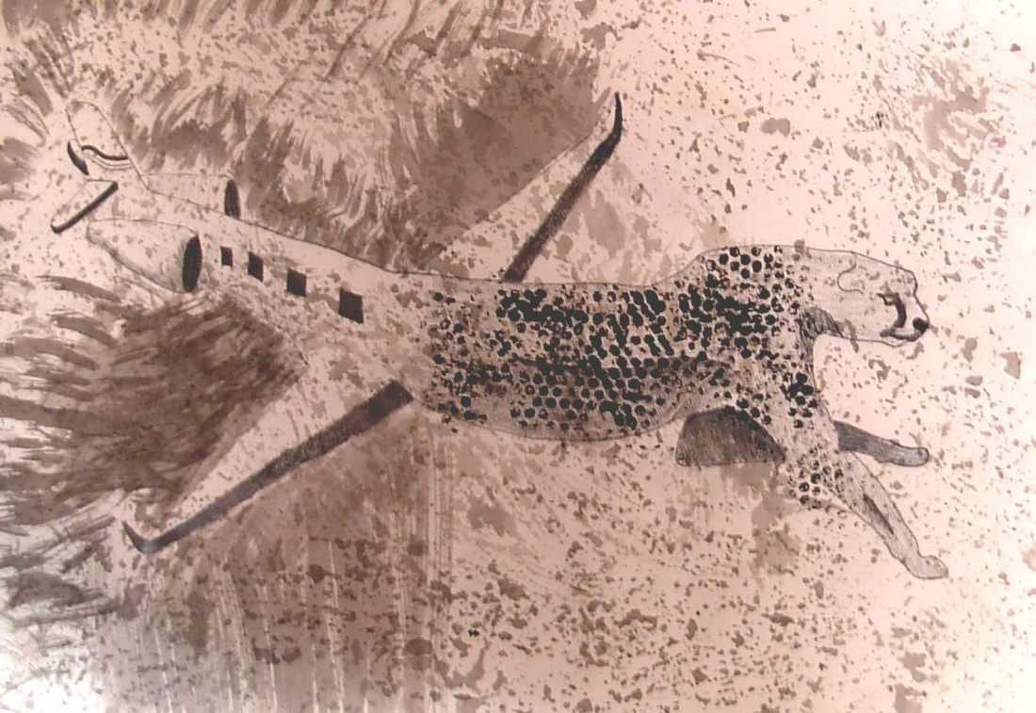

Slide 12
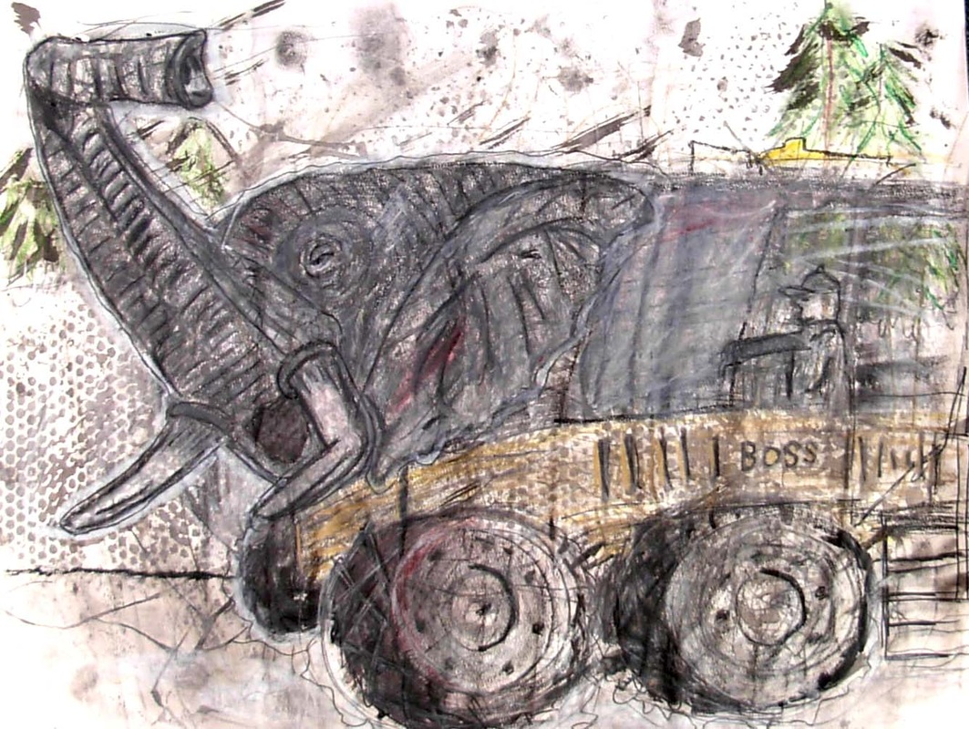

Slide 13
Directions:
write a list of possible animal machine combinations in your sketchbook
select best combination
locate images in books or on internet
begin sketches of ideas in sketchbook
finalize sketches into a finished sketch (experiment with colored pencil)
create ground using india ink on 18 by 24 inch paper
Enlarge sketch onto ink ground using ebony pencil and colored pencil

