Slide 1
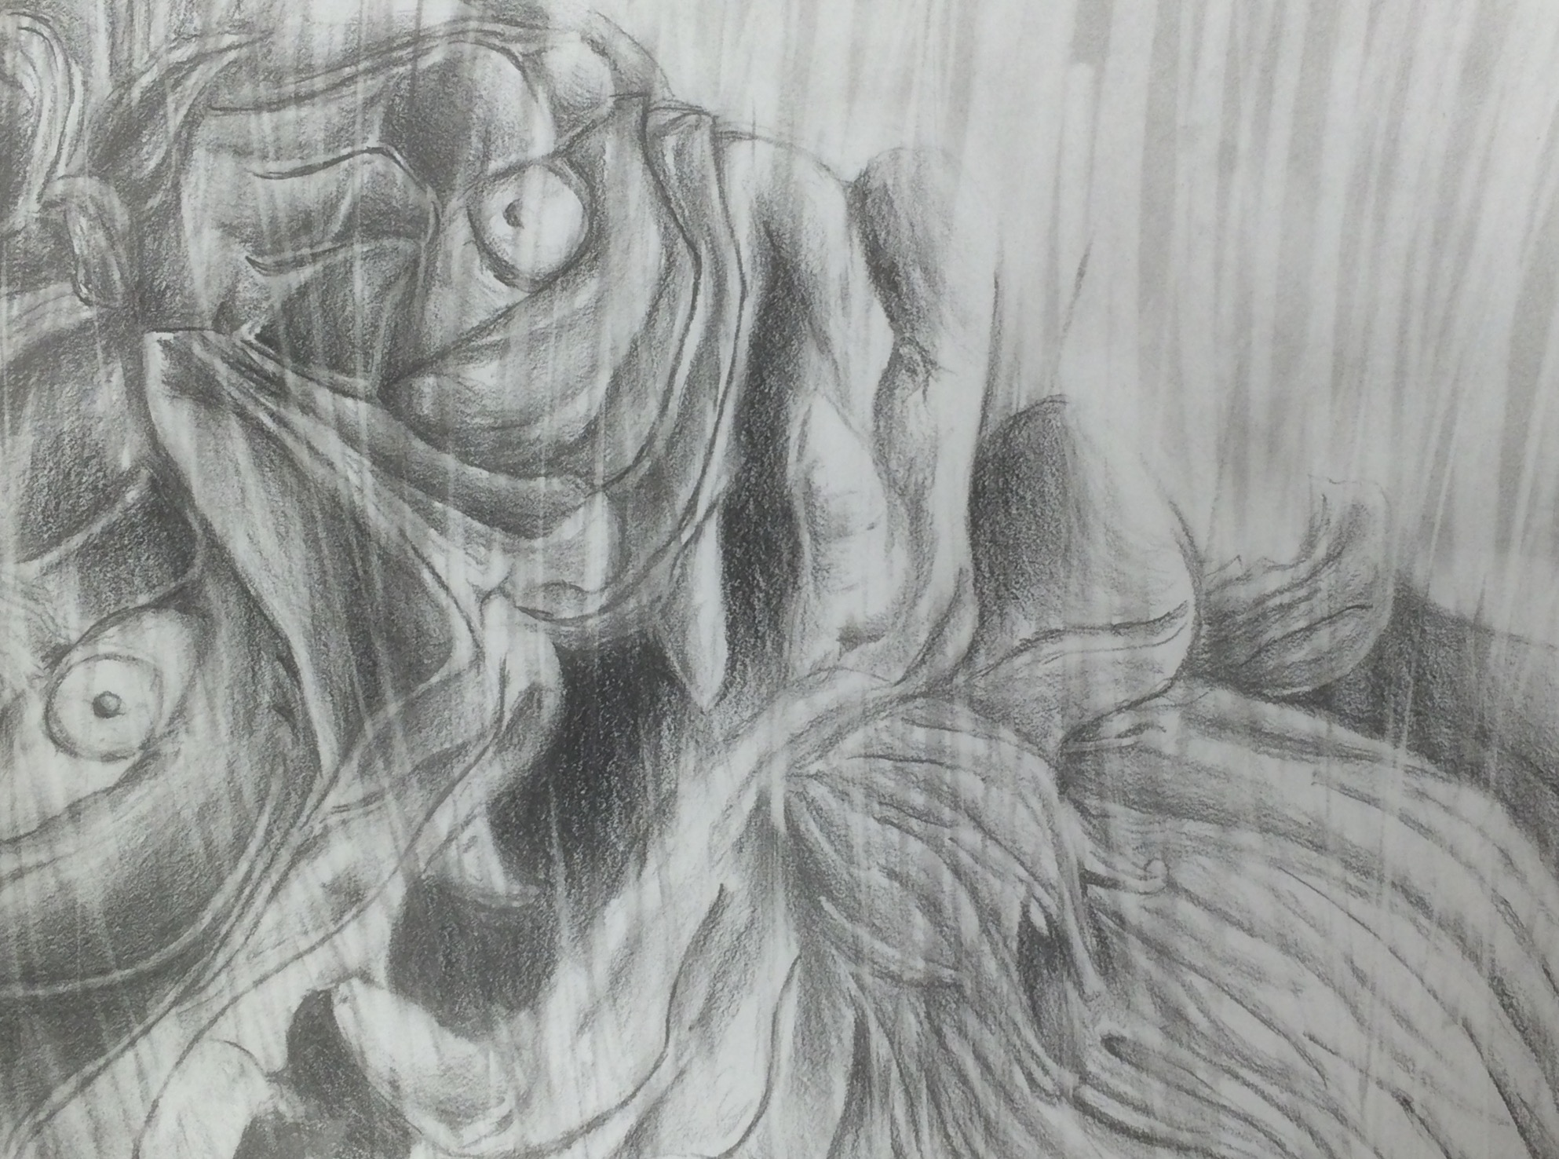
Eraser Drawing
Elements of art: Value, Line, Texture
Principles of Design: Balance, Perspective, Variety

Slide 2
Objectives
Students will experiment with alternative rendering techniques
(eraser as a drawing tool)
Students will master observational drawing
Add energy to a static image

Slide 3
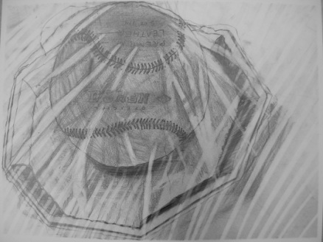
Directions
Select a small, interesting object (or zoom in on an interesting section of a larger object)
place object on a plate and wrap in cellophane
Complete 5-10 thumbnail (small quick) drawings of chosen object in different compositons
Complete a full size sketch (8 by 10)
Practice eraser drawing techniques on small drawing
Choose most successful composition and enlarge onto 18 by 24 paper
Tape edges to board
Render using ebony pencil and eraser

Slide 4
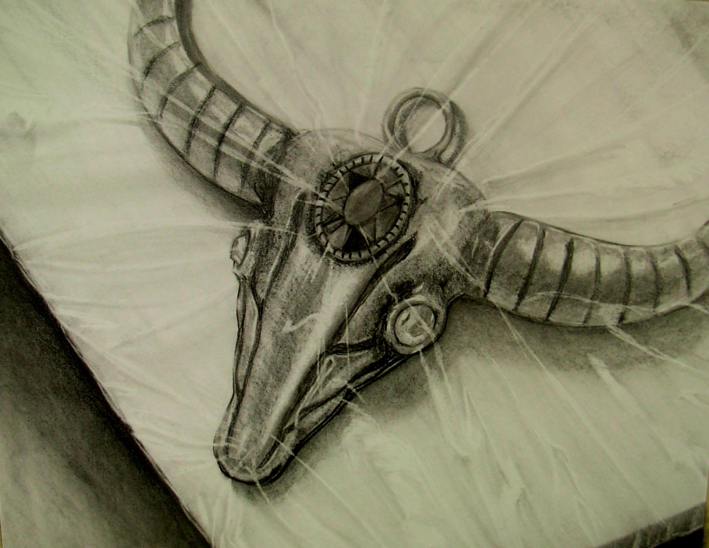

Slide 5
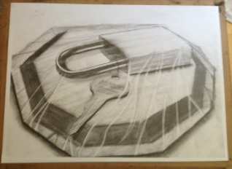

Slide 6
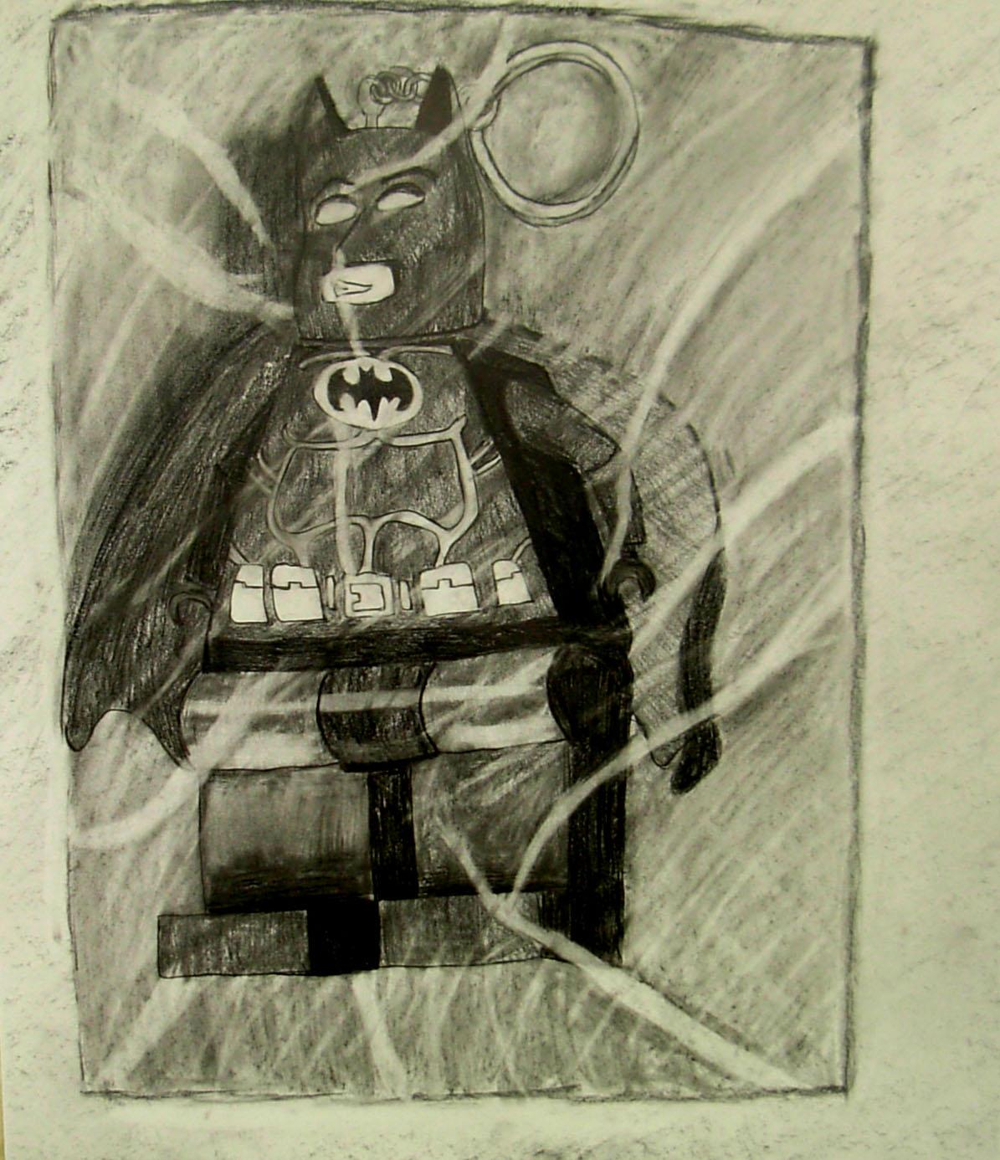

Slide 7
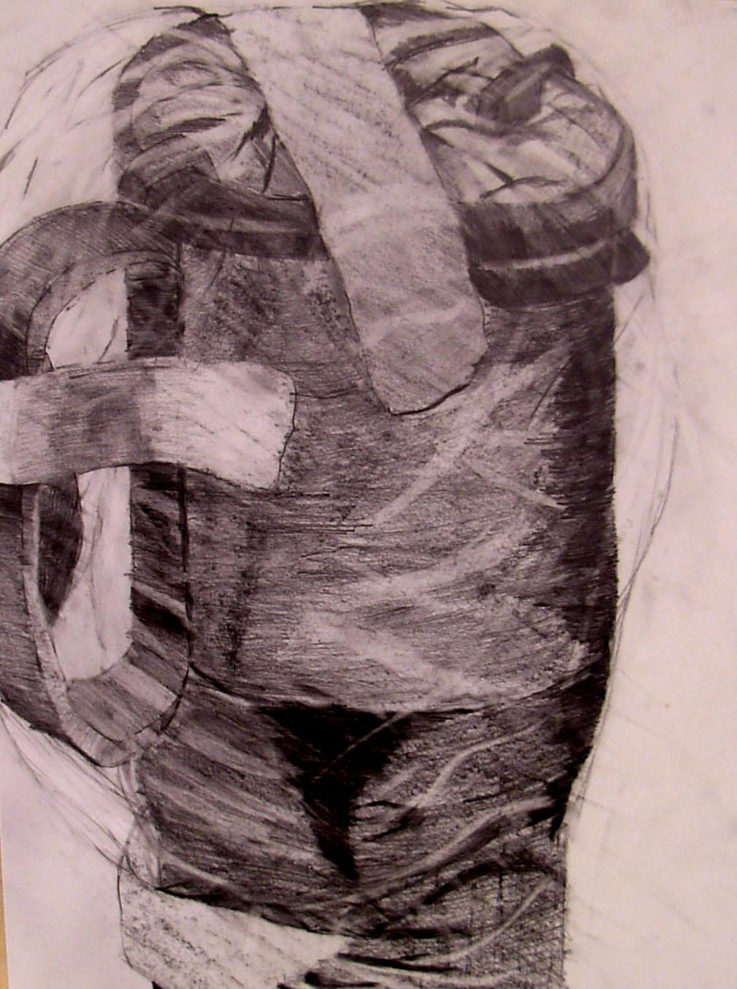

Slide 8
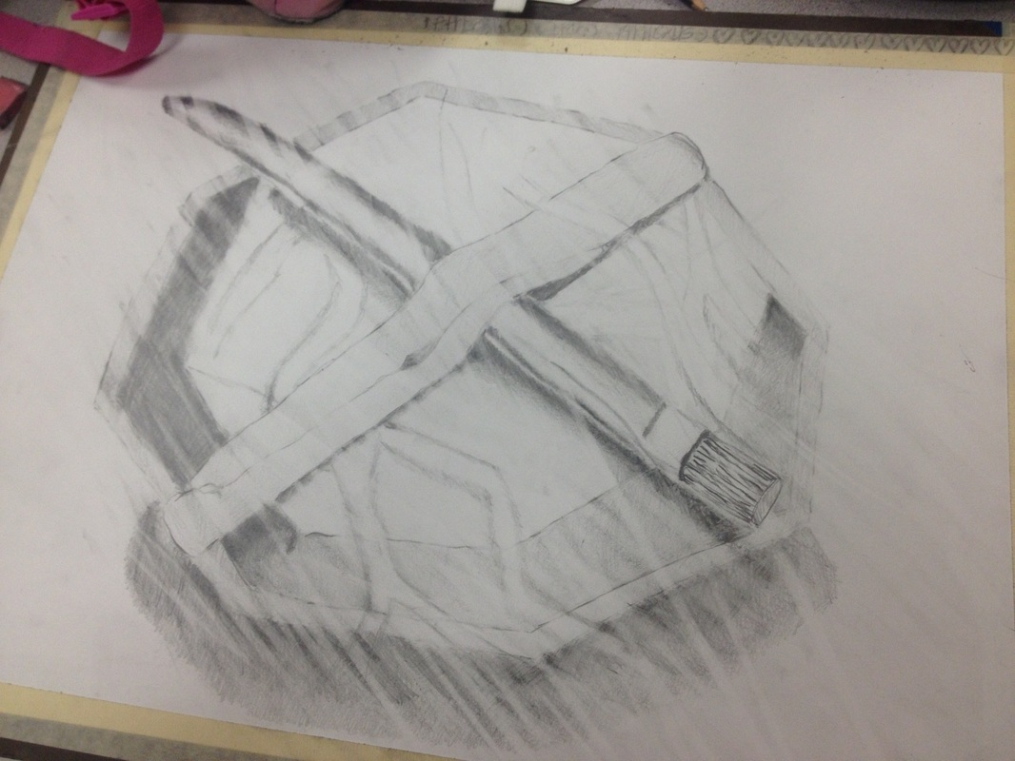

Slide 9
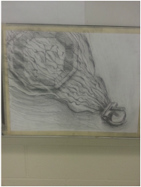

Slide 10
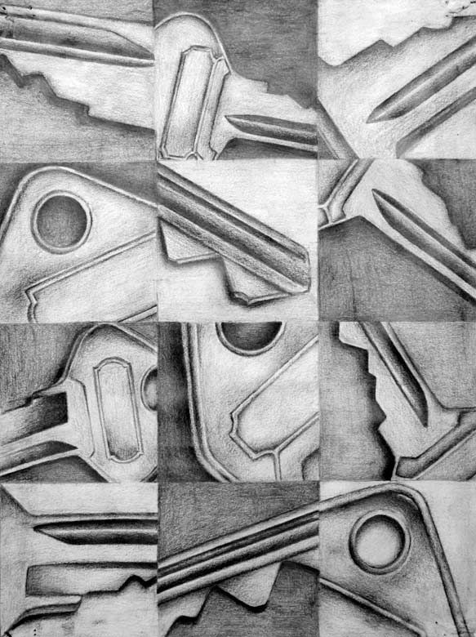

Slide 11
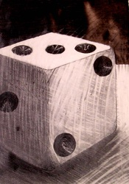
Strong Value range
Dynamic Contrast (background)
Asymmetrical composition
Strong Eraser evidence
Simple object choice
Cast Shadows
Energy in a static object (eraser)

Slide 12
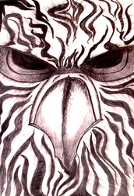
Symmetrical Balance
Strong contrasts
Limited value range
Good eraser evidence
Dynamic composition
Limited depth

Slide 13
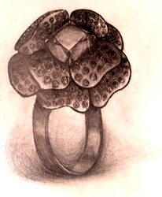
Heavy Value
Off center composition
Cast shadow
Eraser Evidence (minimal)
Simple object choice
Dramatic light

Slide 14
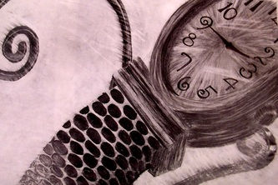
Asymectrical Composition
Great Value range
Strong eraser evidence
High Contrast
Limited details(in specific areas)

Slide 15
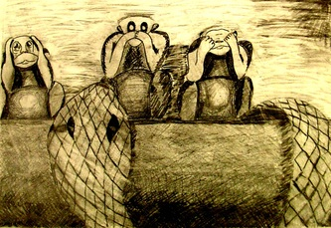
Creative Composition (Slightly off Balance)
Strong eraser evidence
Limited depth
Disproportionate (monkeys)
Limited details (snake and monkeys)
Odd darkened corner (top left)

Slide 16
