Slide 1
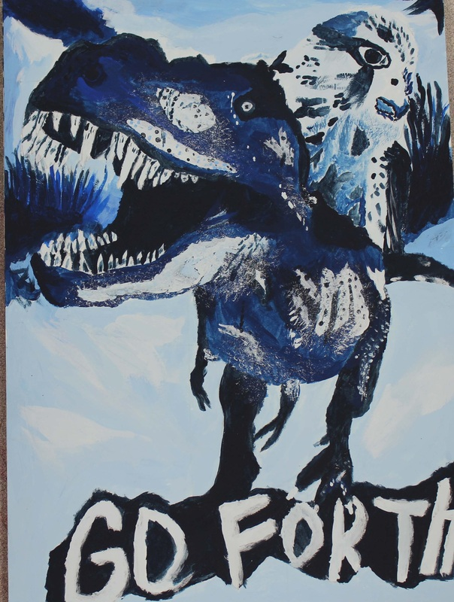
Monochromatic Painting
introduction to painting

Slide 2
Objectives
Create an interesting collage that demonstrates an understanding of balance.
Use the grid drawing system to draw the collage on your board.
Use a monochromatic color scheme to paint your composition.

Slide 3
MONO = ONE
CHROMA =COLOR

Slide 4
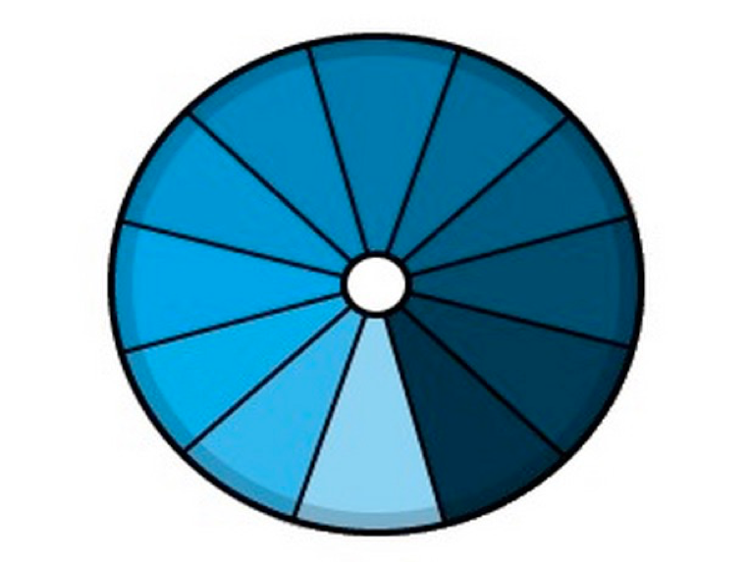

Slide 5
Lighter Add.......
Darker Add.......

Slide 6
First, create a
Non-Collage,......Collage

Slide 7
Background image
Large image
(contrasts background)
Medium image
(compliments large image)
Word or Phrase
(to inspire thought)

Slide 8
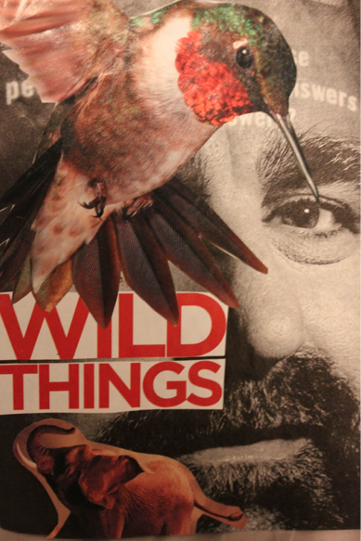

Slide 9
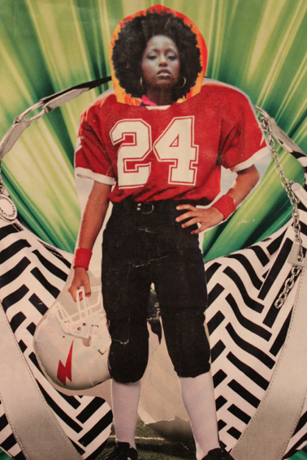
Collect interesting images and text from magazines to create your collage on the paper provided.

Slide 10
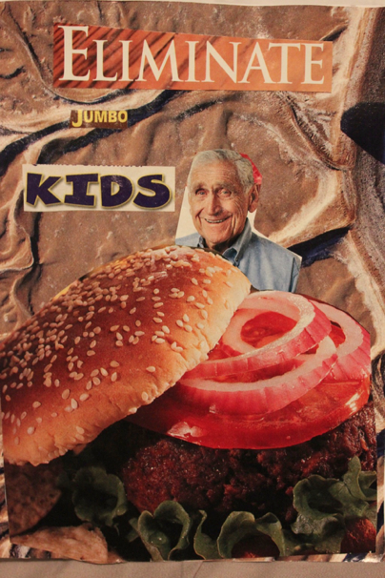

Slide 11
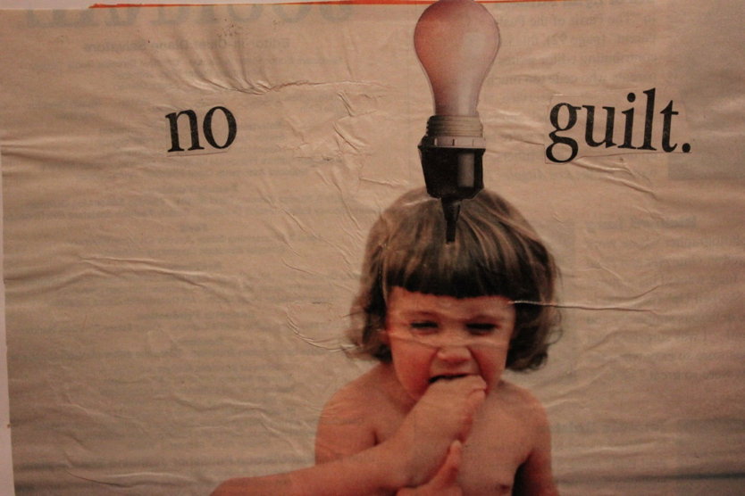

Slide 12
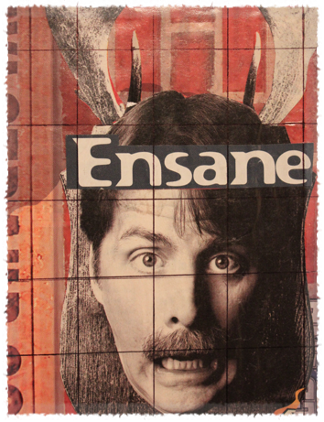
Draw a 1” grid across the entire image

Slide 13
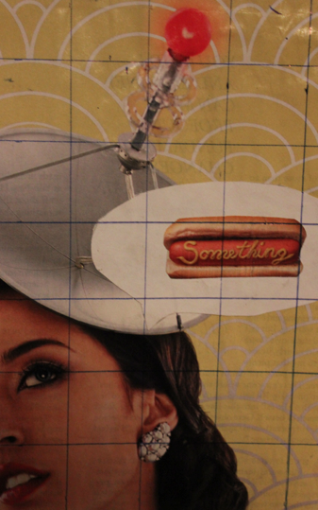
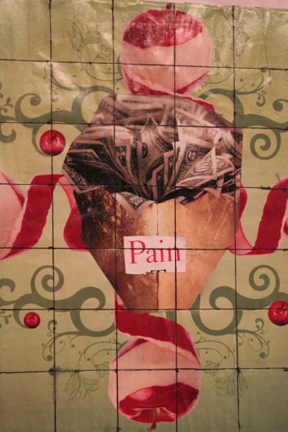

Slide 14
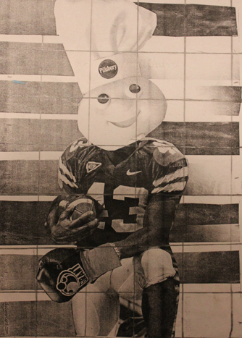

Slide 15
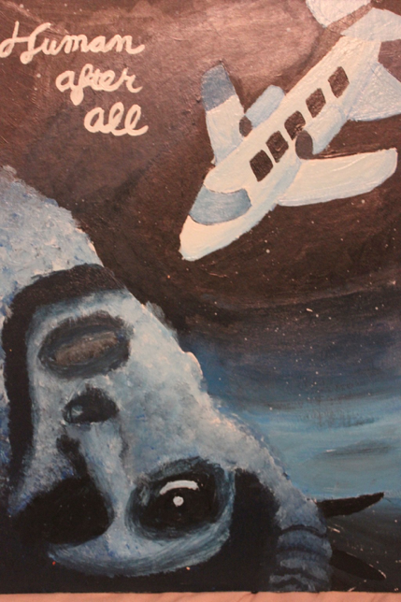

Slide 16
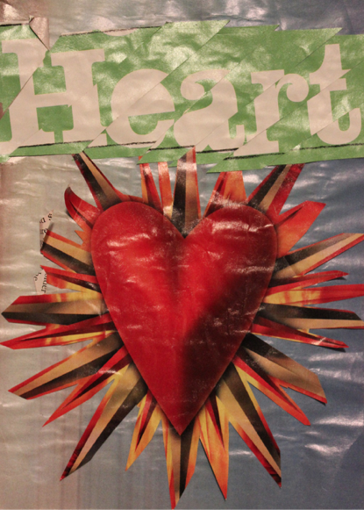
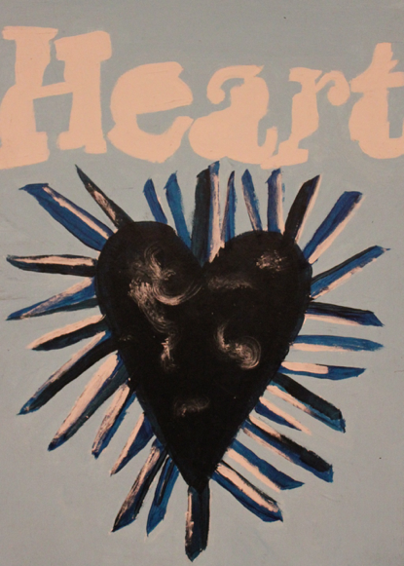

Slide 17
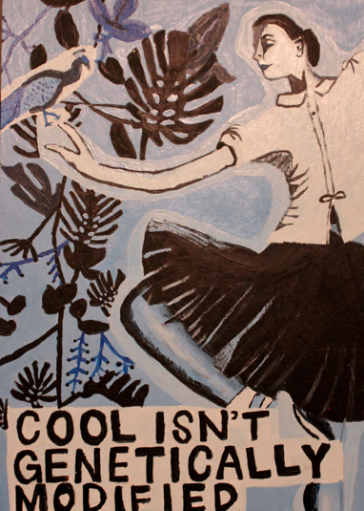

Slide 18
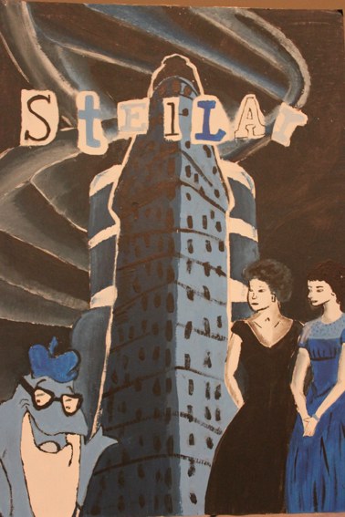

Slide 19
