Slide 1
Styrofoam Intarsia
Advanced 3D design

Slide 2
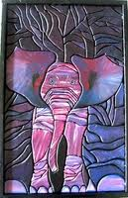
Objectives:
Create original, 3D compositions using styrofoam
Explore image simplification, reduction, and stylized images

Slide 3
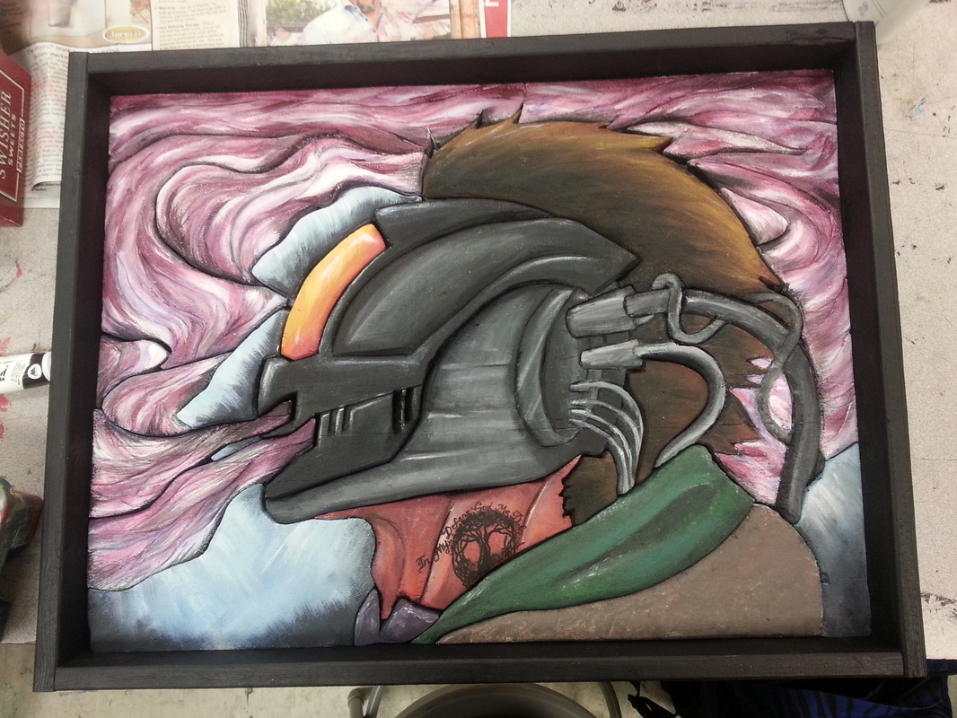

Slide 4
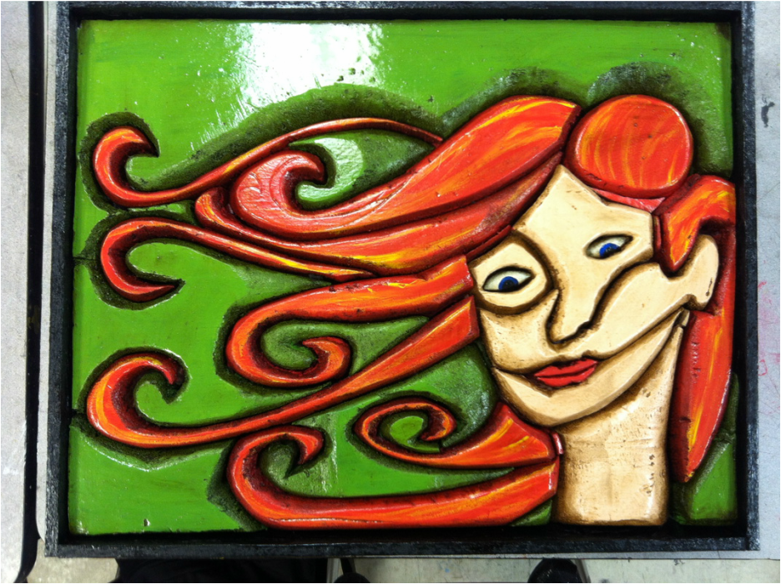

Slide 5
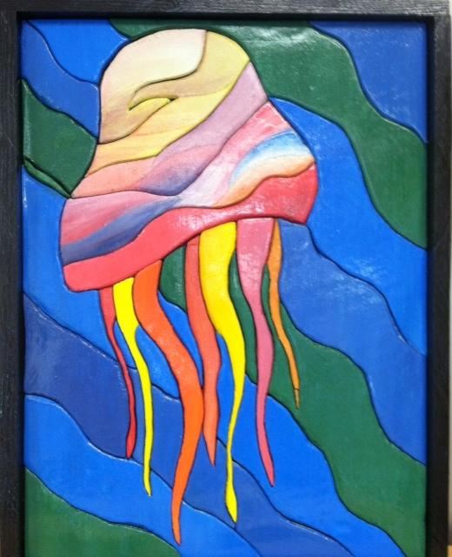

Slide 6
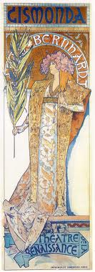
Stylization
Czech painter Alphonse Maria Mucha leapt to fame in Paris in 1895 when his poster Gismonda (1894) for the superstar Sarah Bernhardt heralded the birth of the distinctive ‘Style Mucha’ and established him as the pre-eminent exponent of French Art Nouveau.
http://www.muchafoundation.org

Slide 7
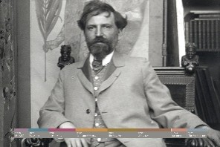
Mucha

Slide 8
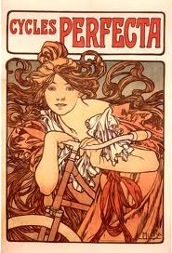

Slide 9
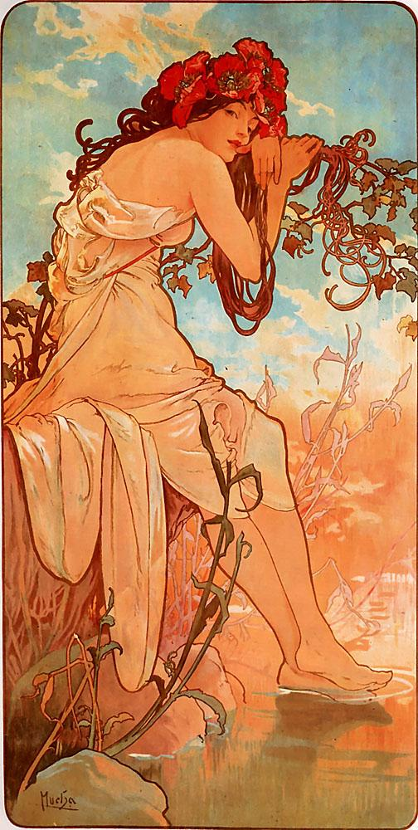

Slide 10
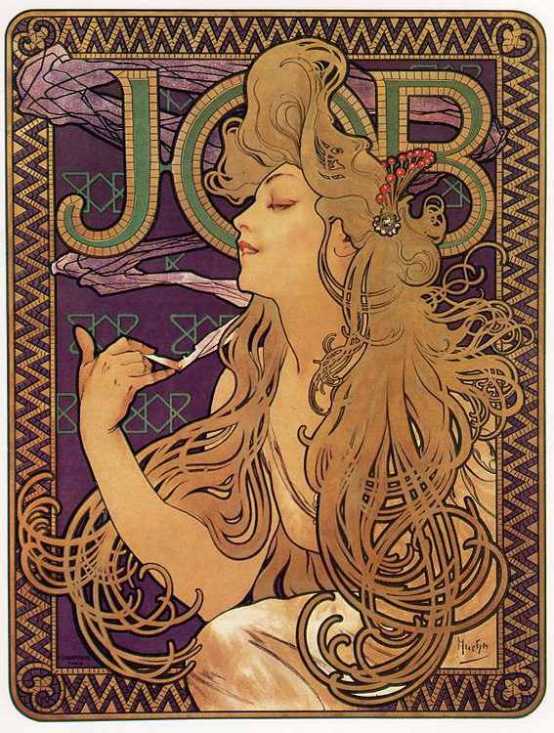

Slide 11
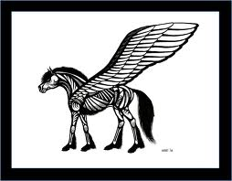

Slide 12
Intarsia
the fitting together of different species of wood like a puzzle

Slide 13
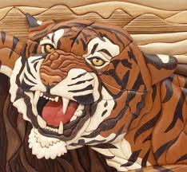

Slide 14
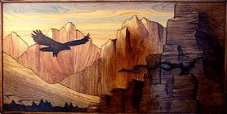

Slide 15
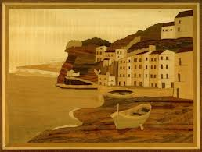

Slide 16
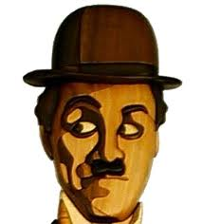

Slide 17
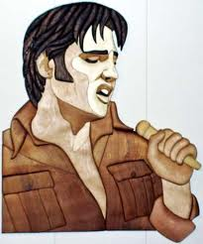

Slide 18
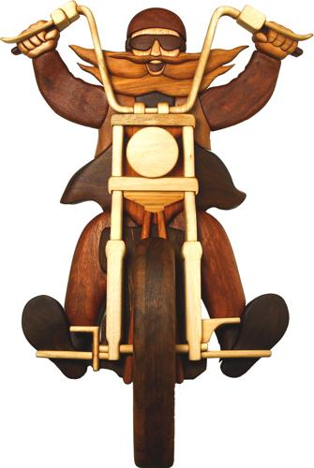

Slide 19
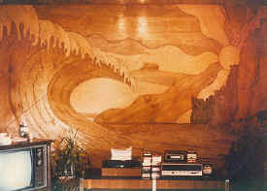

Slide 20
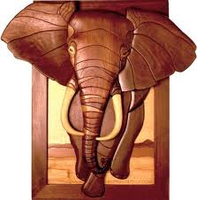

Slide 21
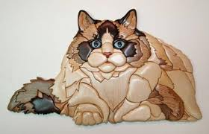

Slide 22
Process

Slide 23
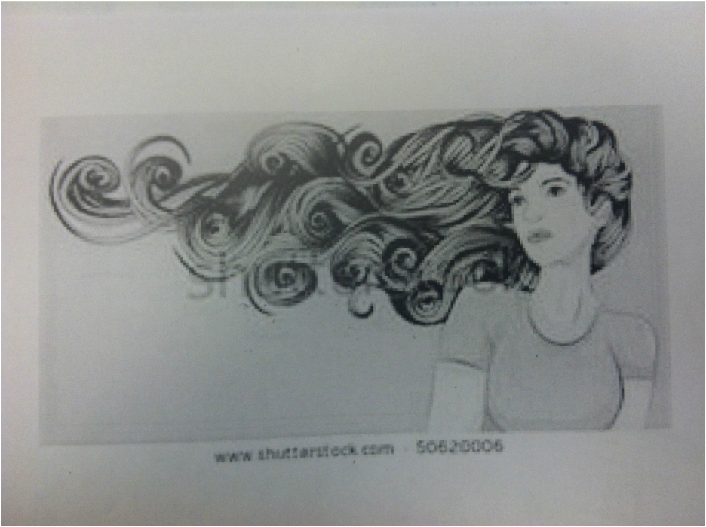
Locate imagery as reference or draw original imagery

Slide 24
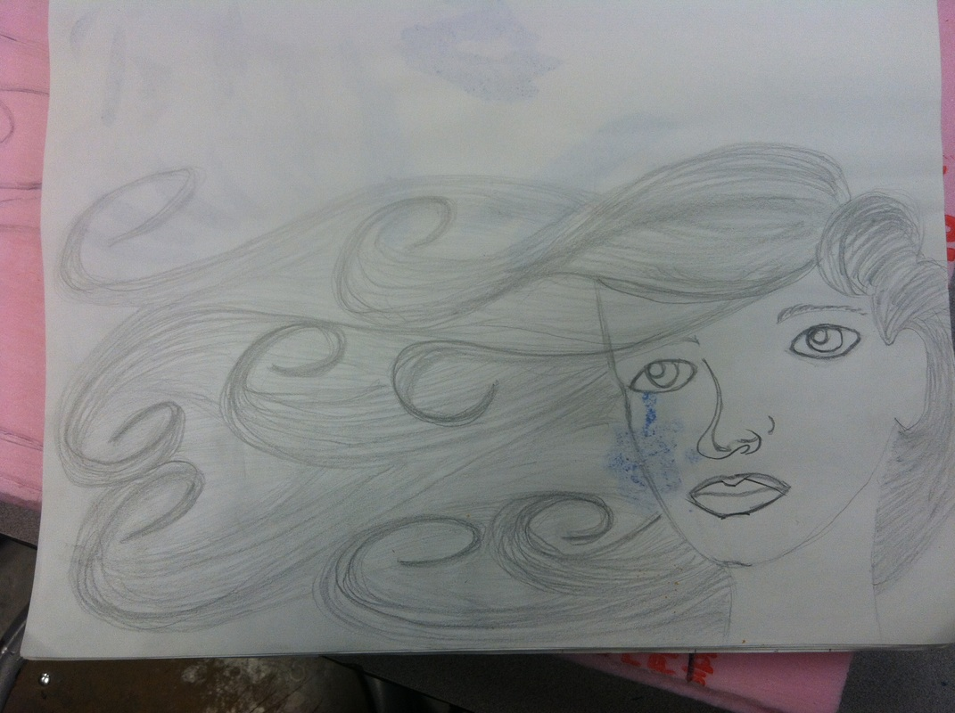
Draw your version

Slide 25
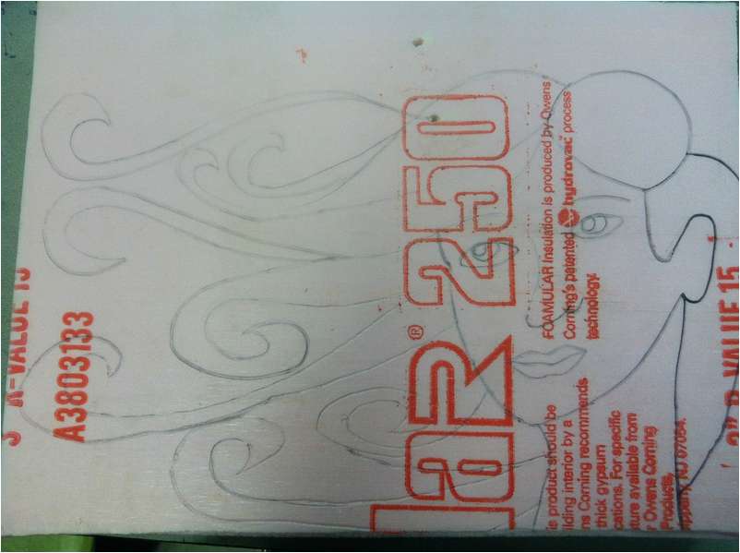
Transfer drawing to styrofoam

Slide 26
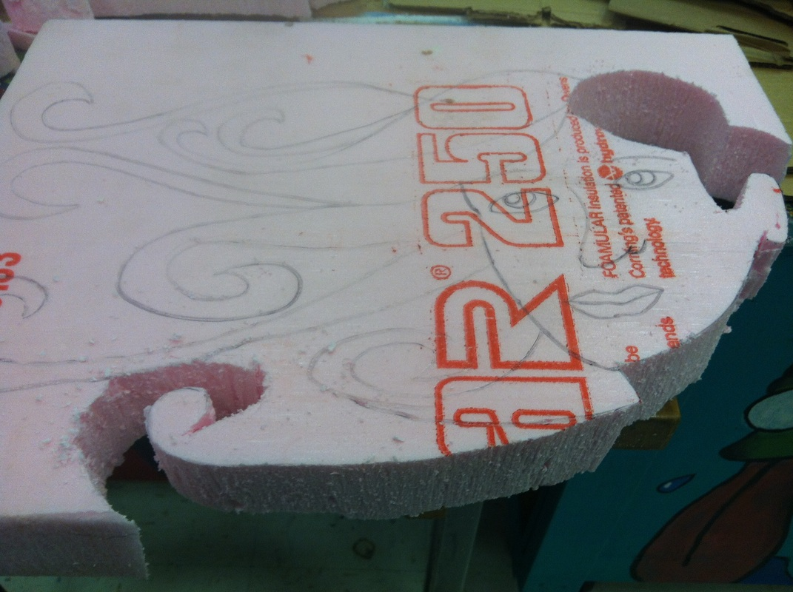
Cut using hand held scroll saw

Slide 27
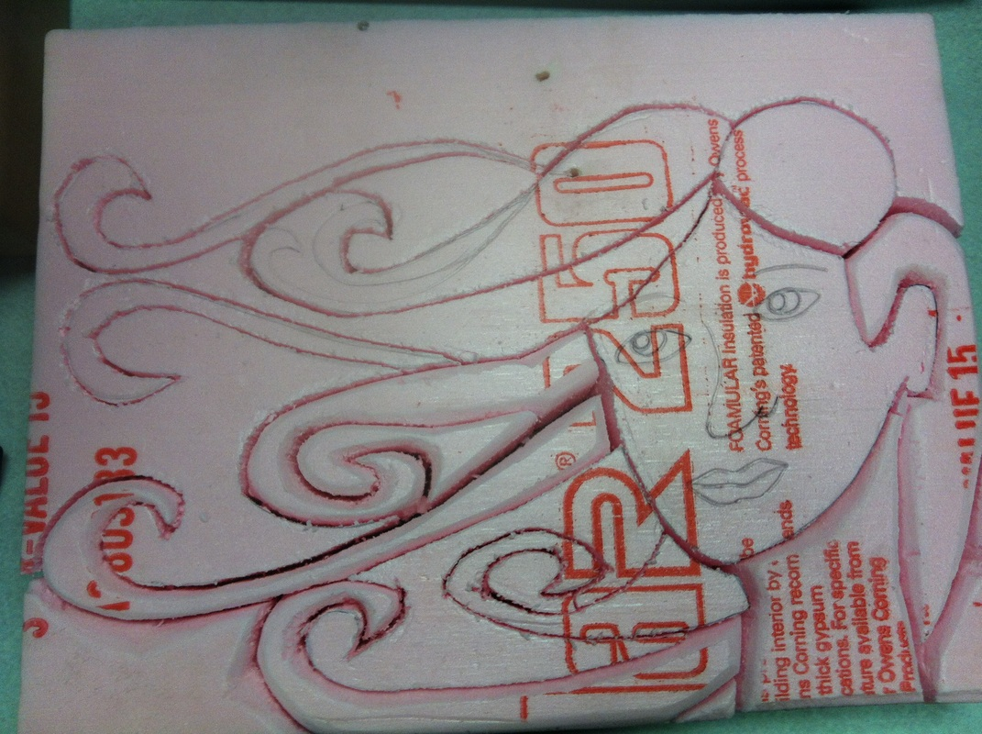
Round over edges using sand paper

Slide 28
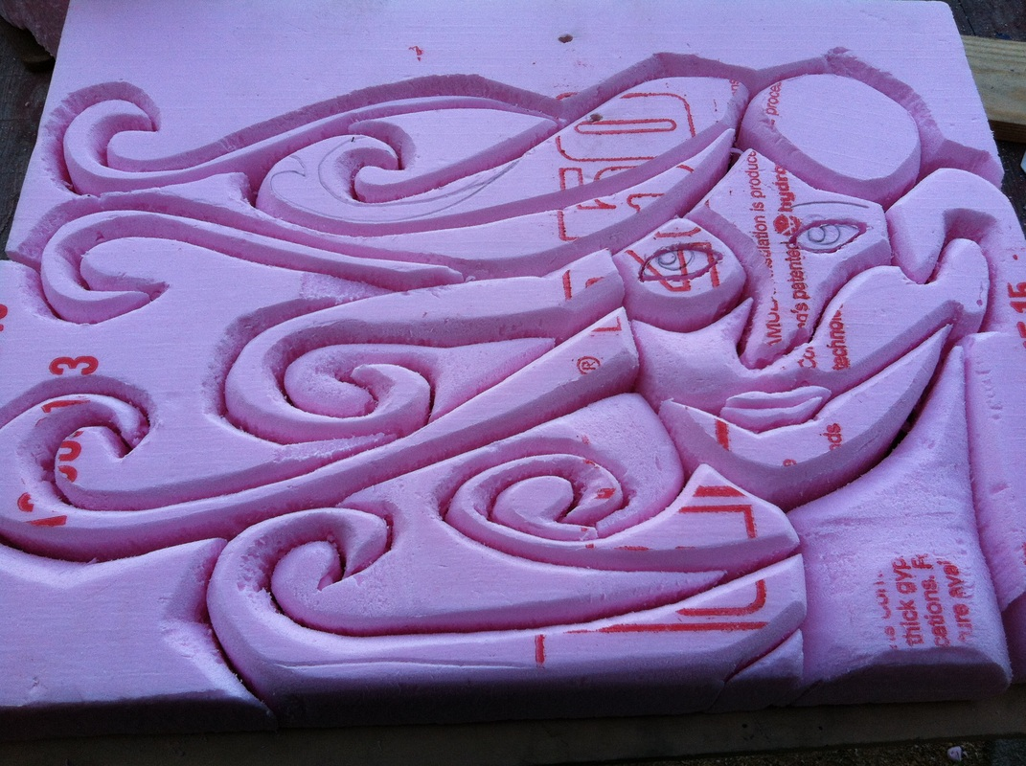

Slide 29
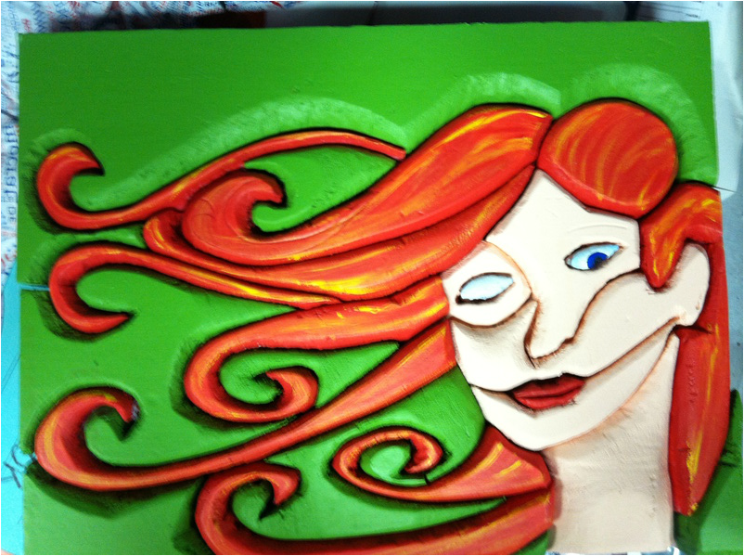
Paint pieces indivudually

Slide 30
Glue into premade frame and polyurethane

Slide 31
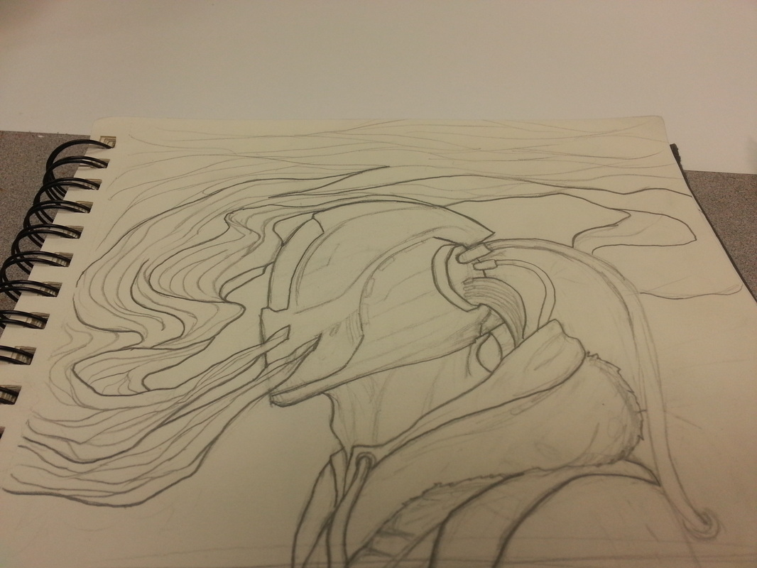

Slide 32
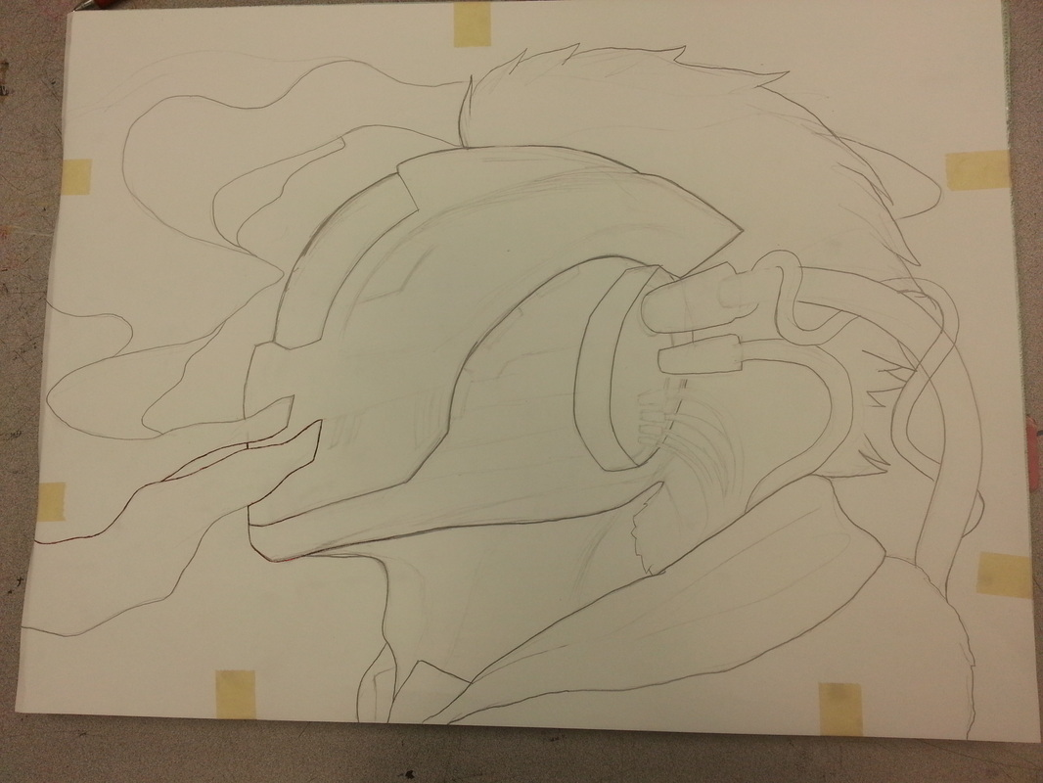

Slide 33
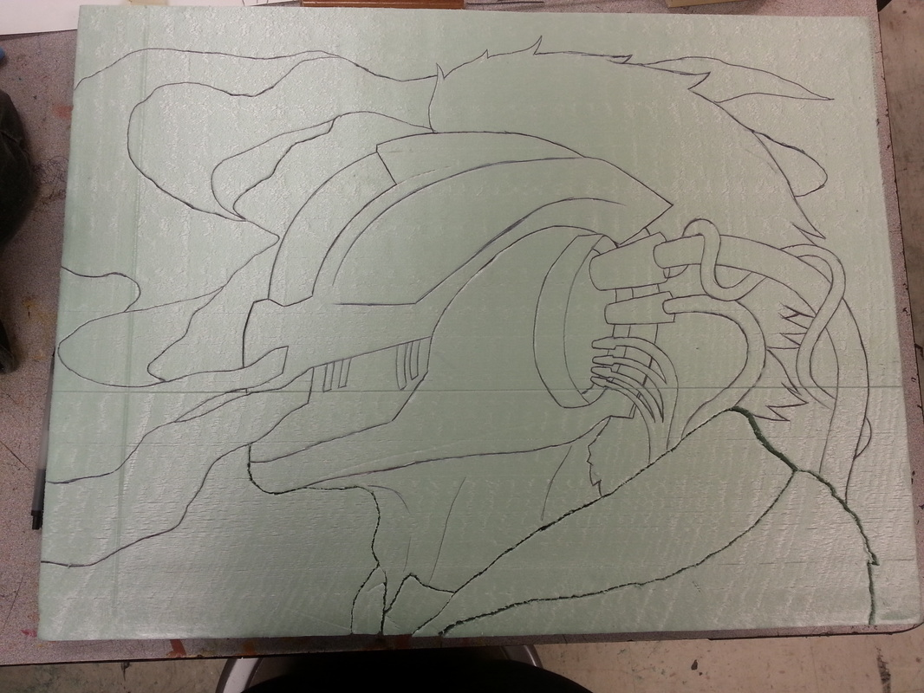

Slide 34
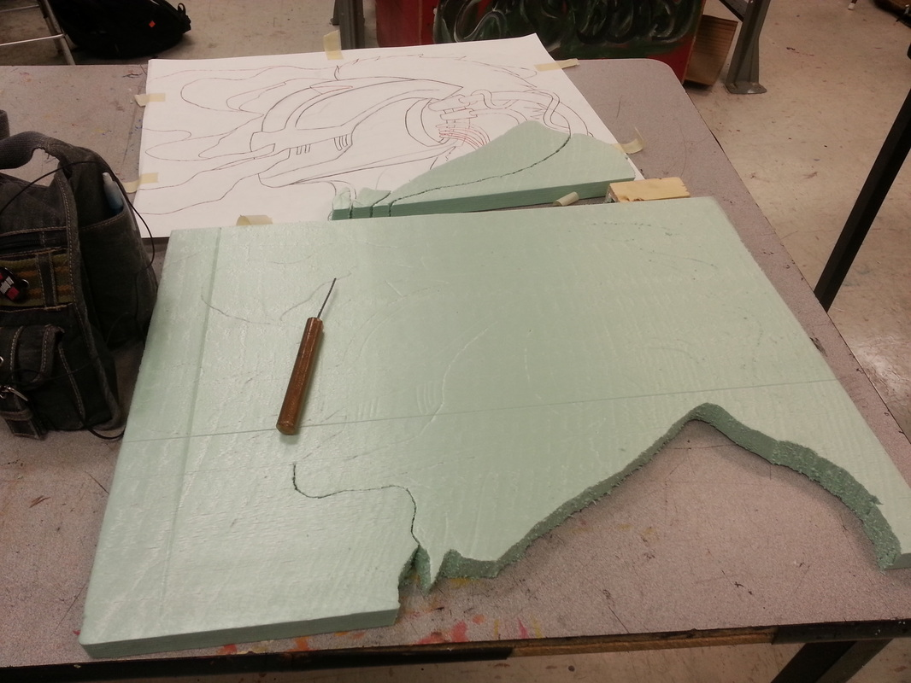

Slide 35
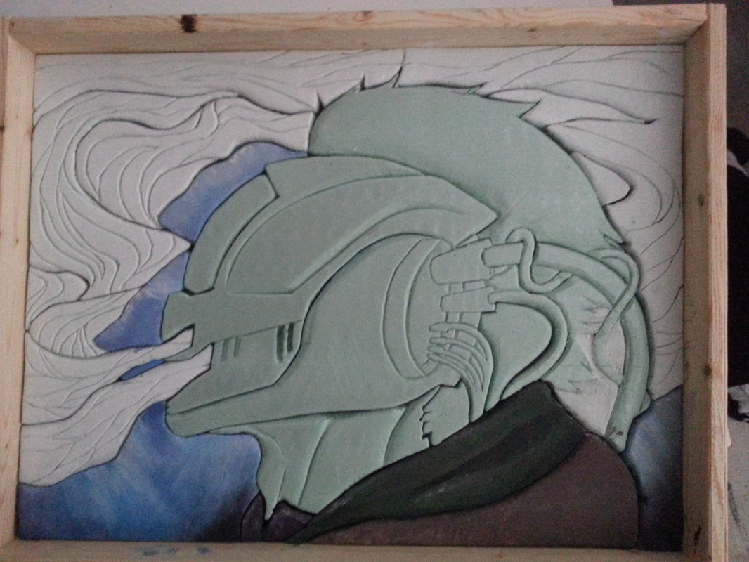

Slide 36
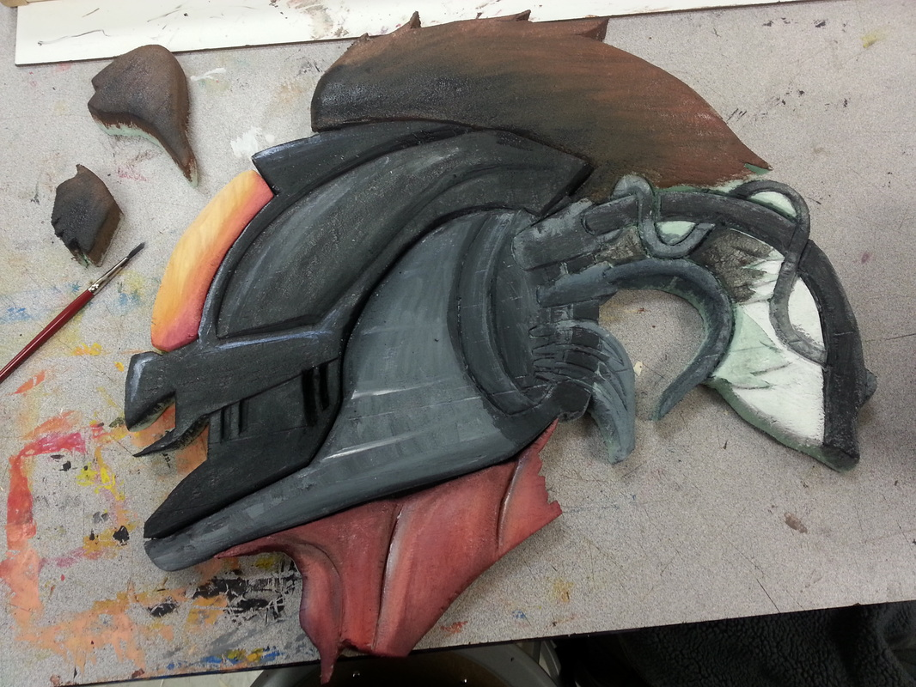

Slide 38
Grading:
Originality of design
Craftsmanship
Use of 3D (height of relief)
Paint Quality (use of paint)
Use of Stylization
Overall Visual Quality

